Slide 1
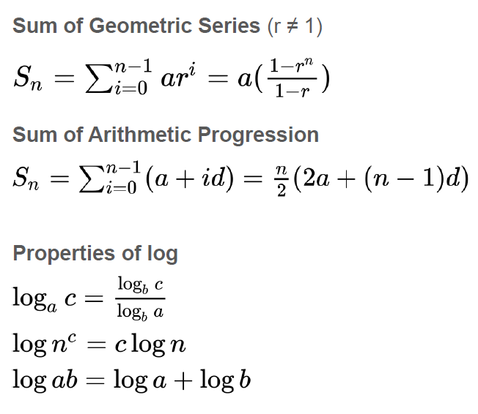
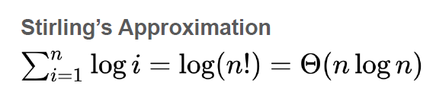
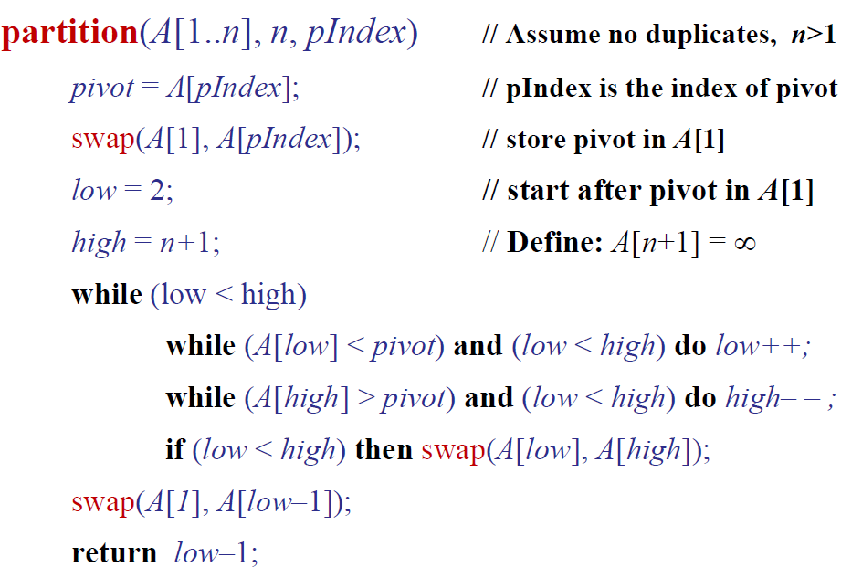
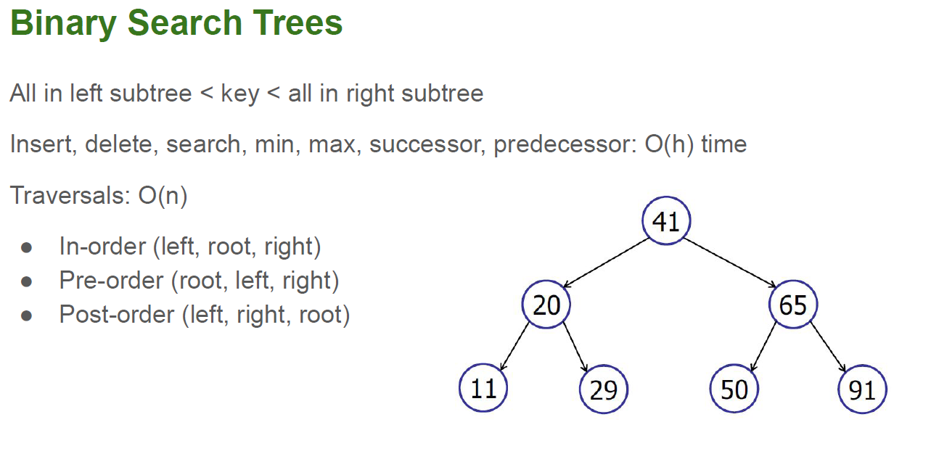
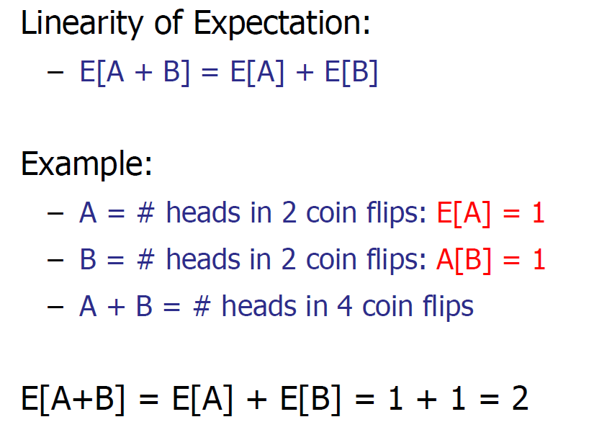
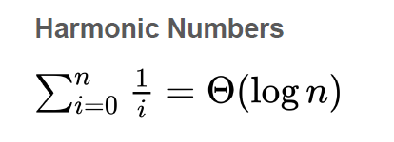
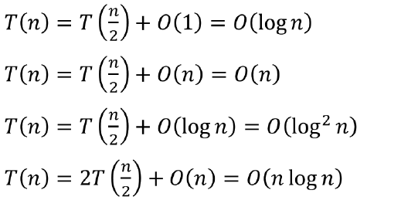
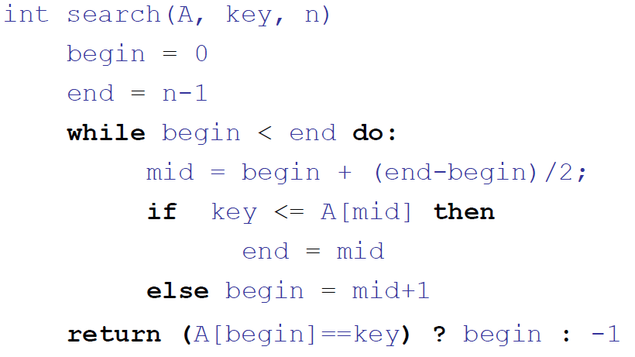
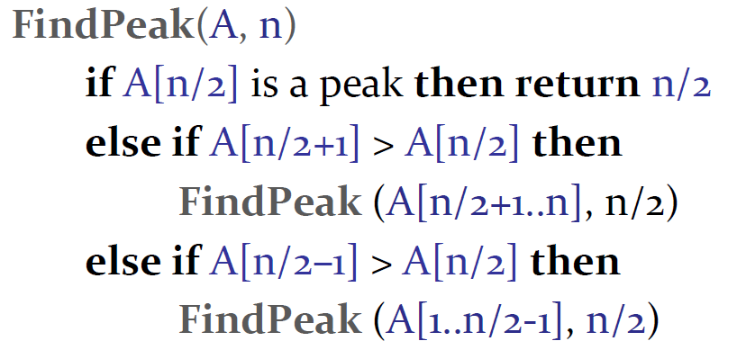


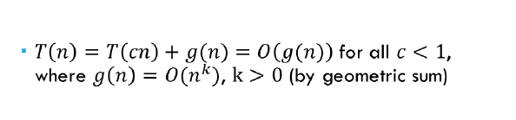
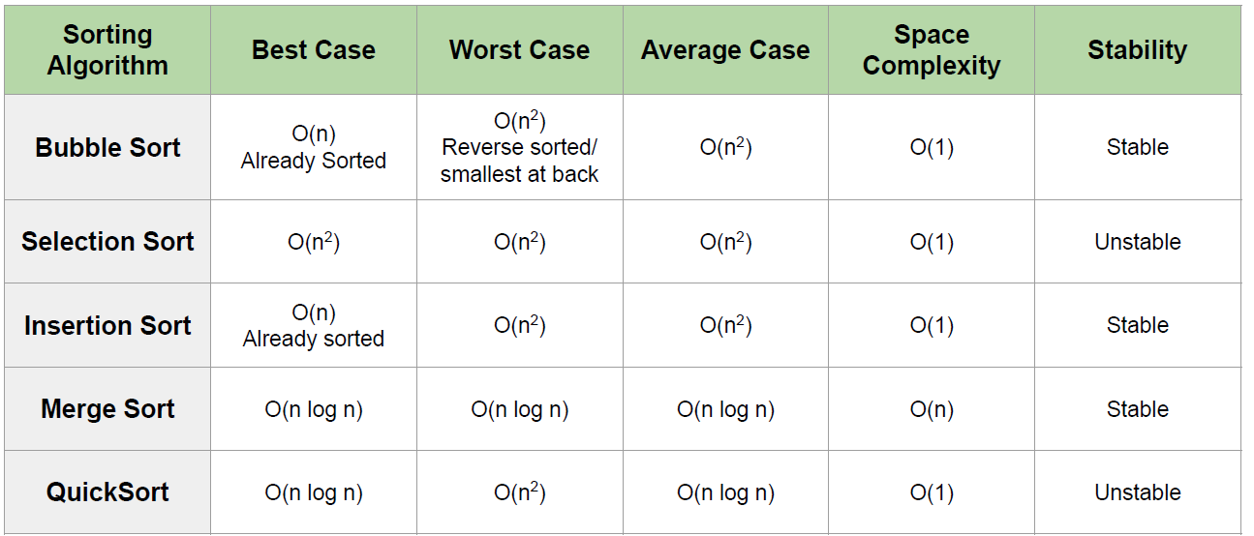
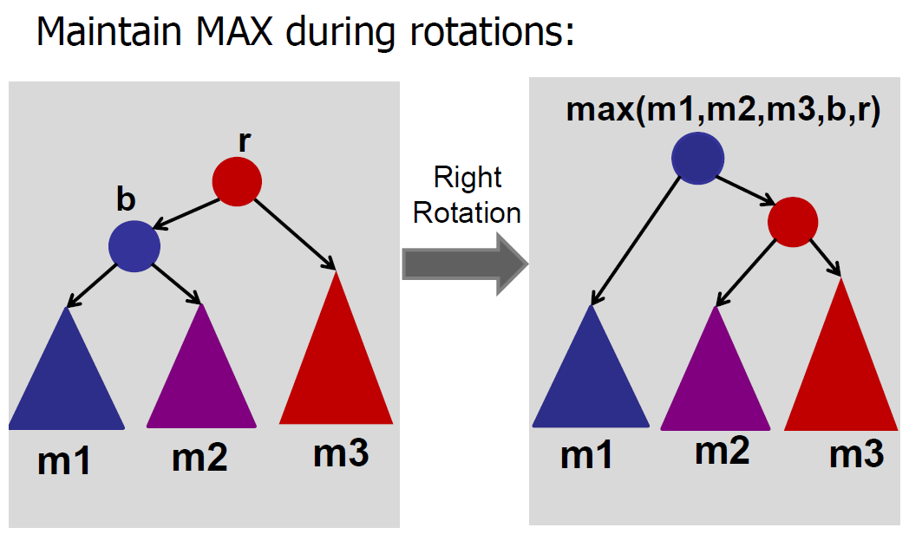
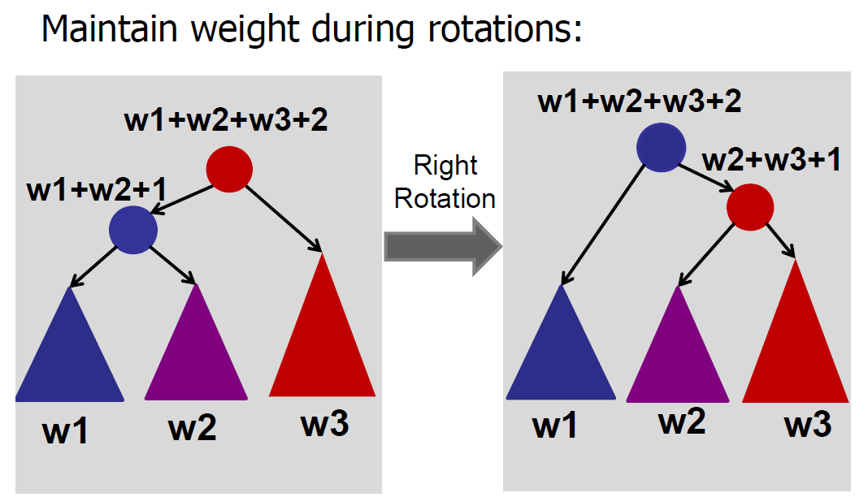

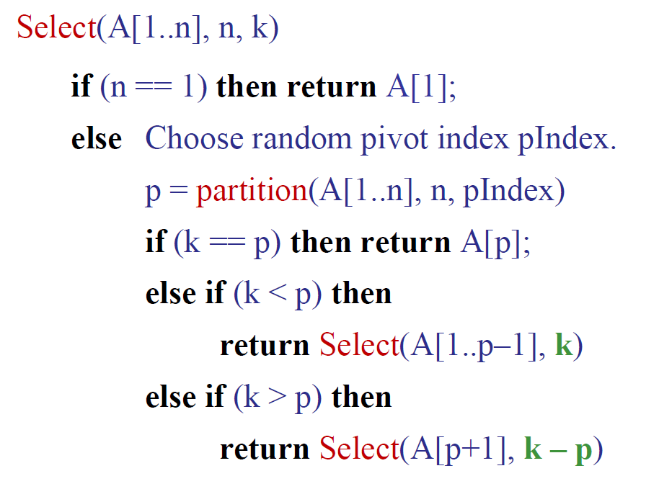
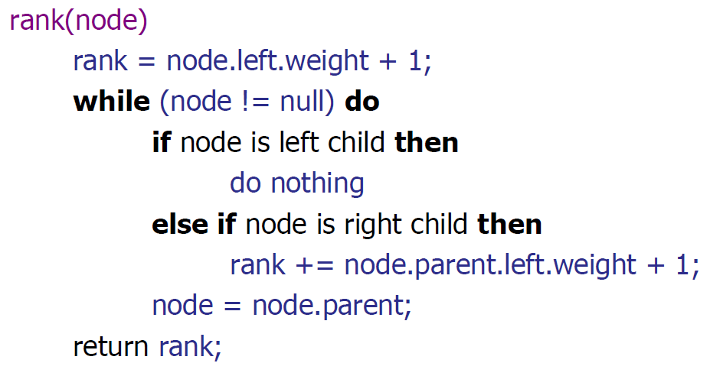
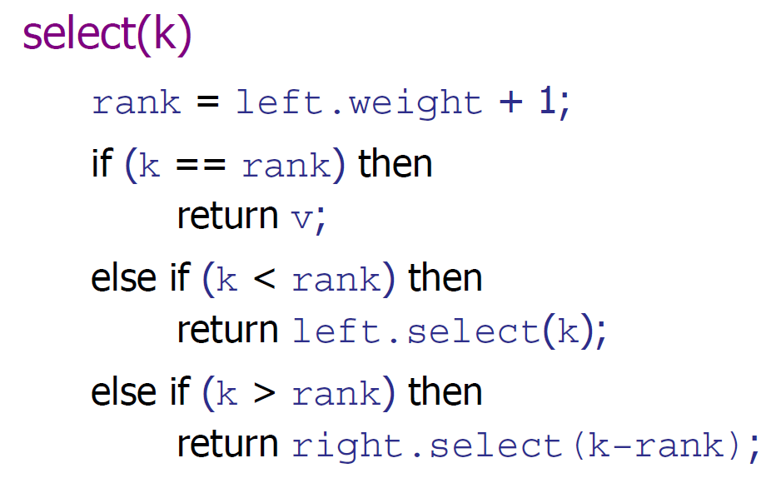
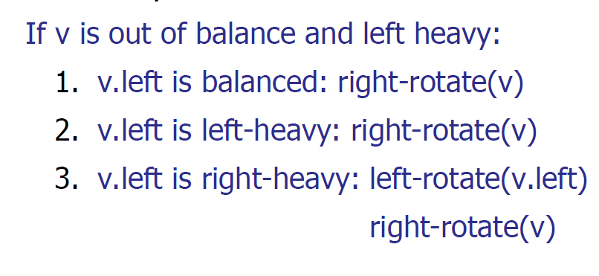
Binary Search:
Use for continuous functions
Use to reduce the problem size each time
Used to optimise solns
DO IT FOR HIM
AVL Tree
Height-balanced: diff in heights in subtrees at most 1
Supports Insert, delete, search, min, max, successor/predecessor in O(log n)
Good for maintaining order
Posb augmentations: store count/max/min/parent pointer/weight/height diff
When to use?
When no need to sort the whole array
Finding median

Slide 2
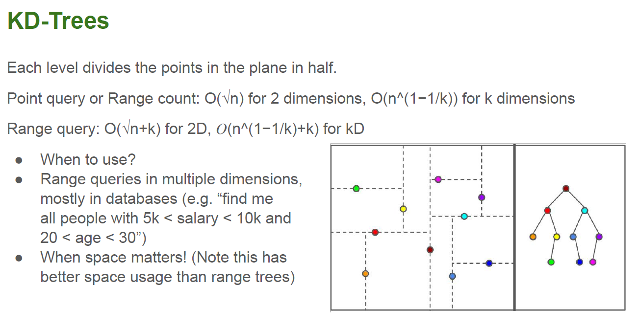
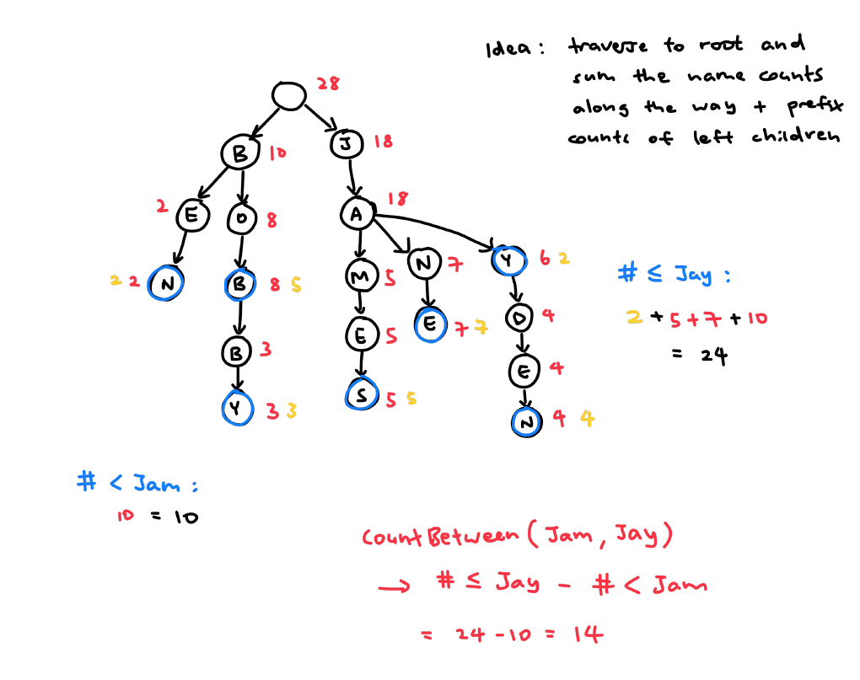
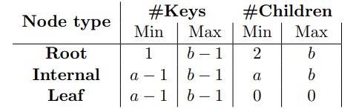
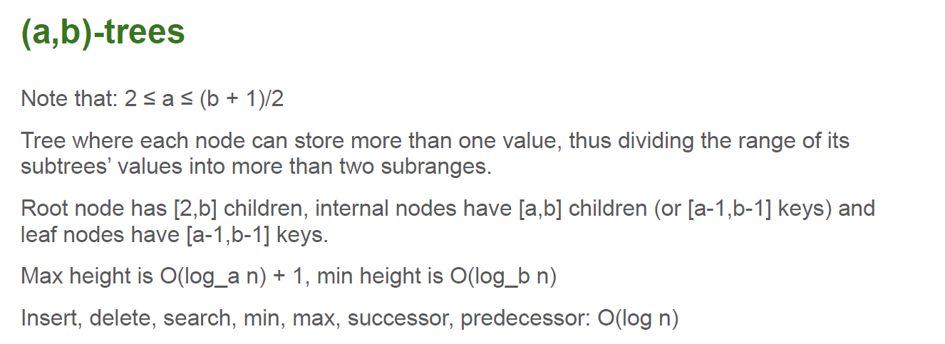
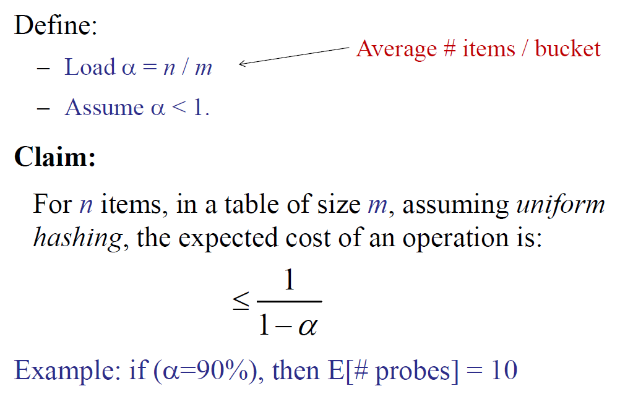
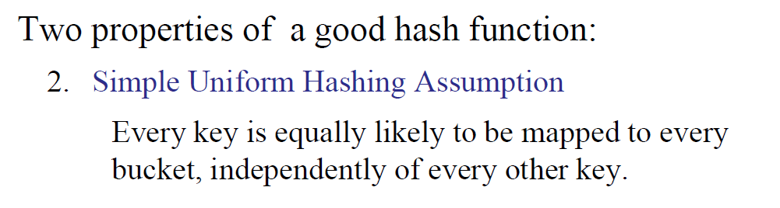
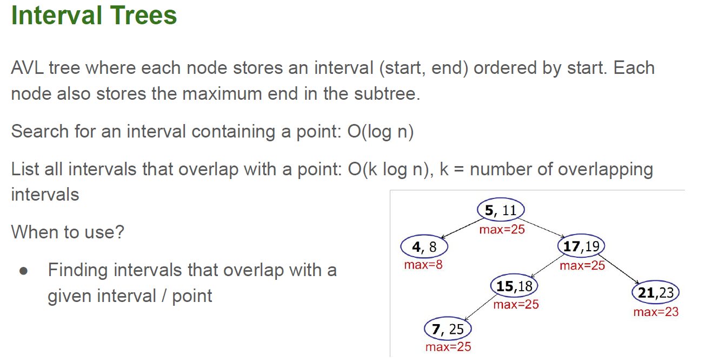
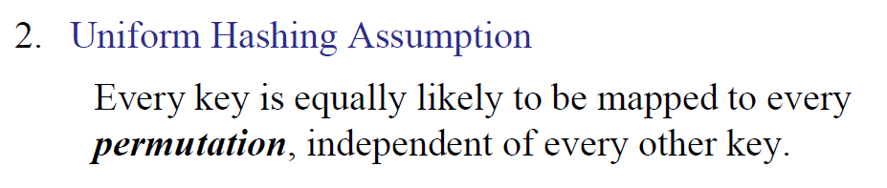
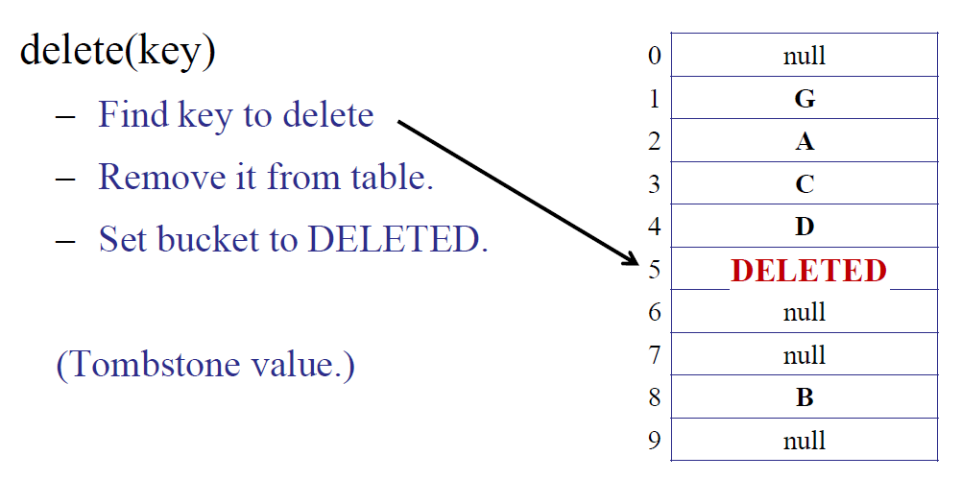
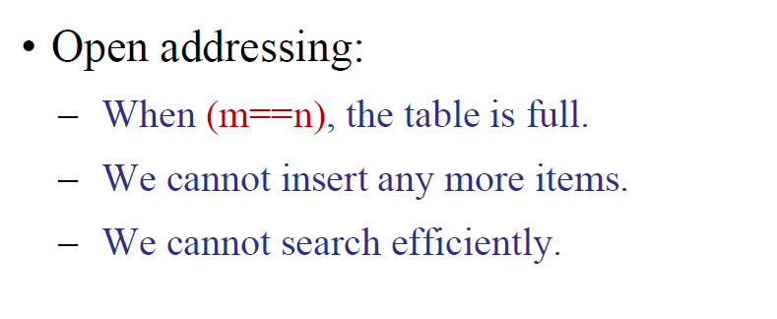
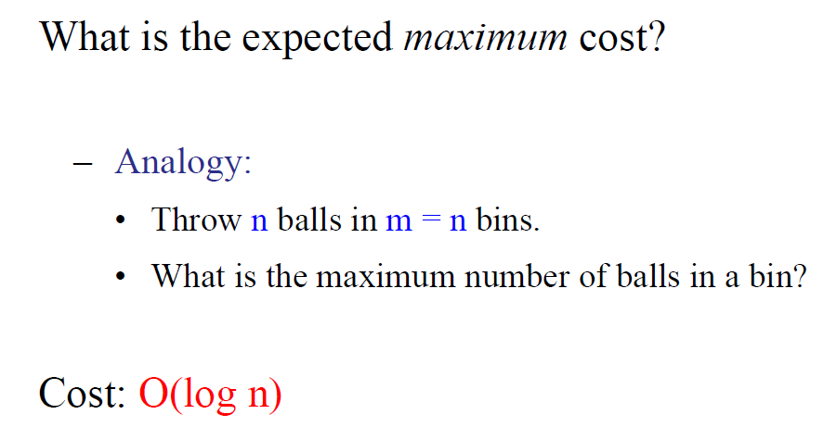
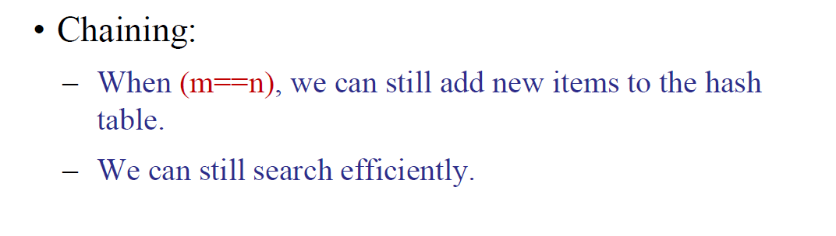
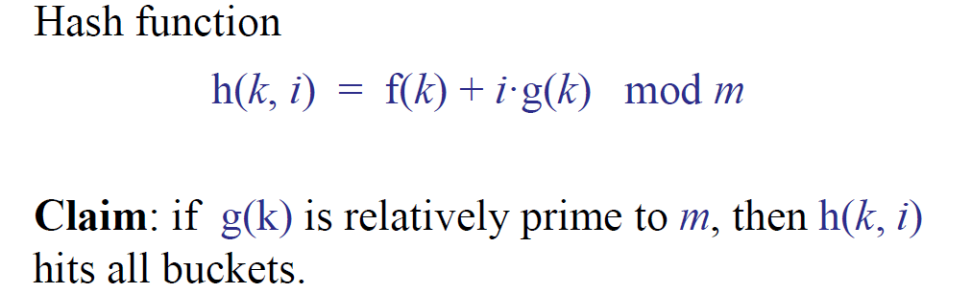
Trie vs AVL
Both take O(L) to compare strings
Insertion for AVL: O(L log n)
Insertion for Trie: O(L)
Space complexity is both O(total string length)
Trie tend to have more overhead cost
Idea: traverse to the root and sum the name counts along the say + prefix counts of the left children
# <= Jay:
2 + 5 + 7 + 10 = 24
# <= Jam:
10 = 10
Count Between(Jam, Jay) →
#<=Jay - #<= Jam
= 24 – 10 = 14
Hashing (chaining)
Insertion: O(1 + cost(h))
Searching: O(n + cost(h)) - when all items hash to the same bucket
Space: O(m + n), where m = size of hash table, n = sum(lengths of linked lists)
Stack (FILO/LIFO)
push/pop/peek → O(1)
Queue (FIFO)
En/Dequeue/peek → O(1)
When to use
When need to process items in a specific seq
When trying out diff permutations

